Slide 1
Mitos: Thread Chondrion: Granule.
MITOCHONDRIA
Mitochondria

Slide 2
History:
Kolliker (1880) first observed it as cytoplasmic granules in striped muscles of insects.
Altman (1894) established them as cell organelles and called Bioblast.
Flemming & Altman was credited for its discovery.
Term 'Mitochondria' was given by C.Benda. F.Meves (1904) first observed them in plants (Nymphea).
Kinsberg & Hogeboom (1948) related them with cell respiration.
Seikevitz called them power house of cell.

Slide 3
Mitochondria

Slide 4
Small granular, filamentous bodies of cytoplasm
Found in all aerobically respiring cells
Contain enzymes and co-enzymes responsible for energy metabolism.
Closely related with cellular respiration
Membrane-enclosed organelle found in most eukaryotic cells.
These organelles range from 0.5 to 1.0 μ m in diameter.
(15000 Aº long & 5000 Aº wide)
Mitochondria are sometimes described as "cellular power plants" because they generate most of the cell's supply of adenosine triphosphate (ATP), used as a source of chemical energy.

Slide 5
Shape: Filamentous granular
May change became rod, club, ring etc.
Size: 3-10 μ m and 0.5-1 μ m diameter
Smallest- 1 μ m in yeast
Largest- 20-30 μ m in oocytes of amphibians
pH, cell environment, osmotic pressure related to the shape and size
Number of mitochondria: Varies, related to functional state of cell.
Liver cell:1000-1600
Renal tubule: 300-400
Sea urchin egg 13000-14000
Human sperm- 25
Scattered in cytoplasm in most of cells

Slide 6
In addition to supplying cellular energy, mitochondria are involved in a range of other processes, such as signaling, cellular differentiation, cell death, as well as the control of the cell cycle and cell growth
Mitochondria have been implicated in several human diseases, including mitochondrial disorders and cardiac dysfunction and may play a role in the aging process.

Slide 7
The number of mitochondria in a cell varies widely by organism and tissue type.
Many cells have only a single mitochondrion, whereas others can contain several thousand mitochondria
The organelle is composed of compartments that carry out specialized functions.
These compartments or regions include the outer membrane, the intermembrane space, the inner membrane, and the cristae and matrix.

Slide 8
Structure
A mitochondrion contains outer and inner membranes composed of phospholipid bilayers and proteins
The two membranes, however, have different properties.
Because of this double membrane organization, there are five distinct compartments within the mitochondrion.
There is the
outer mitochondrial membrane,
The intermembrane space (the space between the Outer and inner membranes),
The inner mitochondrial membrane,
The cristae space (formed by infoldings of the inner membrane), and
The matrix (space within the inner membrane).

Slide 9
Internal structure of a mitochondrion

Slide 10
Outer membrane
The outer mitochondrial membrane, which encloses the entire organelle, has a protein-to-phospholipid ratio similar to that of the eukaryotic plasma membrane
Each membrane about 60 Aº in thickness
It contains large numbers of integral proteins called porins.
These porins form channels that allow molecules
5000 Daltons or less in molecular weight to freely diffuse from one side of the membrane to the other.

Slide 11
Intermembrane space:
The intermembrane space (60-80 Aº) is the space between the outer membrane and the inner membrane.
Because the outer membrane is freely permeable to small molecules
One protein that is localized to the intermembrane space in this way is cytochrome c

Slide 12
Inner membrane
The inner mitochondrial membrane contains proteins with five types of functions.
Those that perform the redox reactions of oxidative phosphorylation
ATP syntheses, which generates ATP in the matrix
Specific transport proteins that regulate metabolite passage into and out of the matrix
Protein import machinery.
Mitochondria fusion and fission protein

Slide 13
Cristae:
The inner mitochondrial membrane is compartmentalized into numerous cristae, which expand the surface area of the inner mitochondrial membrane, enhancing its ability to produce ATP.
For typical liver mitochondria the area of the inner membrane is about five times greater than the outer membrane.
This ratio is variable and mitochondria from cells that have a greater demand for ATP, such as muscle cells, contain even more cristae.
These folds are studded with small round bodies known as F₁ particles or oxysomes. .

Slide 14
Elementary particle/F1 Particle/oxysomes/ETP
Outer membrane particles; 60 A⁰, stalk less
Inner membrane particles; 160 A⁰, with head, stalk & base (80 A⁰,50 A⁰, 80A⁰, )

Slide 15
Cross-sectional image of cristae in rat liver mitochondrion to demonstrate the likely 3D structure and relationship to the inner membrane.

Slide 16
Mitochondrial matrix:
The matrix is the space enclosed by the inner membrane.
It contains about 2/3 of the total protein in a mitochondrion.
The matrix is important in the production of ATP
The matrix contains a highly-concentrated mixture of hundreds of enzymes, special mitochondrial ribosome's, tRNA, and several copies of the mitochondrial DNA genome.
Of the enzymes, the major functions include oxidation of pyruvate and fatty acids, and the citric acid cycle
Mitochondria have their own genetic material, and the machinery to manufacture their own RNAs and proteins .

Slide 17
Chemical composition of Mitochondrion
The mitochondrial memb. has chemical organization
Each memb. Is made up of proteins and lipids
Proteins 65 to 70%, insoluble in water
Lipids 25-30% : composed of 90 % of phospholipids, 5 % cholesterol and
5 % free fatty acids
The molecule phospholipids is insoluble in water but structural group of phospholipids molecule called micelle is soluble
It also consists of 0.5 % RNA, small amount of DNA, S, Fe, Cu and some Vitamins
The mitochondrial DNA is double stranded and circular
More than 70 enzymes and co enzymes in matrix of Mitochondrion

Slide 18
Functions:
The most prominent roles of mitochondria are to produce ATP (i.e., phosphorylation of ADP) through respiration, and to regulate cellular metabolism
The central set of reactions involved in ATP production are collectively known as the citric acid cycle, or the Krebs Cycle.
However, the mitochondrion has many other functions in addition to the production of ATP.

Slide 19
STEPS IN CELL RESPIRATION: 1. GLYCOLYSIS: Breakdown of glucose to pyruvic acid Glucose + Cytoplasmic enzyme ………..→ Pyruvic acid 2. OXIDATION AND DECARBOXYLATION of PYRUVIC ACID : Pyruvic acid+ P. Acid Dehydrogenase enzyme of F1 particle ……→ Acetyl CoA+ 2H⁺+ CO2↑ 3. KREBS CYCLE/ CITRIC ACID CYCLE: (1936) Acetyl CoA+ Oxaloacetic acid, citric acid synthatase → Citric Acid with 6 carbon atom Succinyl CoA →S.A. Thiokinase → Succcinic acid, synthesis of 1 mol. Of ATP 4. OXIDATIVE PHOSPHRYLATION ; The complete oxidation of 1 glucose molecule yields about 38 molecules of ATP C₆H₁₂O_{6+ 6 O2+} 6H2O+38 ADP+38 IP → Respiratory enzymes → 6CO2+12H20+38 mol. ATP

Slide 20
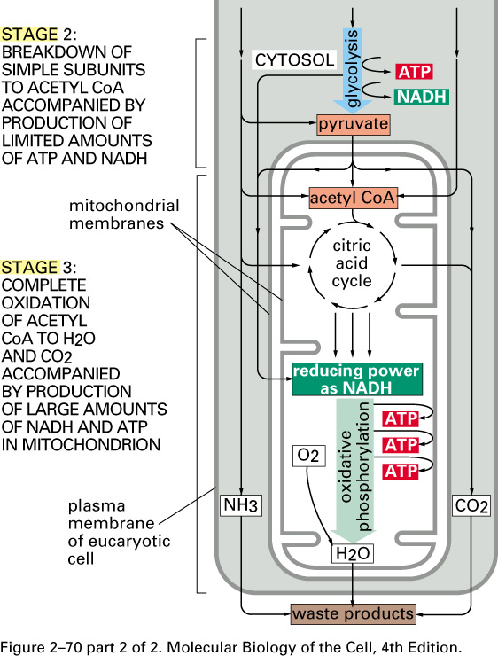
2-70 (Alberts): Cellular metabolism

Slide 21
Additional functions of mitochondria…
Regulation of the membrane potential
Apoptosis-programmed cell death
Calcium signaling
Cellular proliferation regulation
Regulation of cellular metabolism
Some mitochondrial functions are performed only in specific types of cells.
( For example, mitochondria in liver cells contain enzymes that allow them to detoxify ammonia, a waste product of protein metabolism. A mutation in the genes regulating any of these functions can result in mitochondrial diseases.)

