Slide 1
THE CELL

Slide 2
INTRODUCTION:
Cell biology (Cytology)
Kytos=hollow vessel or cell
The biological science which deals with study of structure, function, molecular organization, growth reproduction and genetics of cell is called cytology/ Cell Biology.
Cell is structural and functional unit of life
In short study of structure And functions of the cell called cytology
Biology is the subject of life and living organisms.

Slide 3
General about cell
All organisms from simplest to most complex plants, animals except virus are composed of cells
Some organisms like bacteria, protozoan like amoeba consist of single cell
The organisms with only one cell in their body –unicellular organisms

Slide 4
The organisms having many cells in their body called multicellular organisms Ex. Most of plants and animals.
It is estimated that there are 10 million living species on Earth today.
Any cellular organism contain only one type of cell, i. e prokaryotic or eukaryotic cell
Nucleus was discovered by Brown in 1833
Purkinje (1839) described cell content as protoplasm

Slide 5
Common features of cell
Each cell-mass of protoplasm
Containing cytoplasm with cell organenelles
Centrally nucleus (Nucleoplasm)
Surrounded by plasma membrane.
Definite str. & functional capacities like-
Cell division and reproduction
Store information in genes made up of DNA

Slide 6
Cell shape and size
All eukaryotic cells generally spherical
Shape determine by specific function
Variable from cell to cell
Shape is fixed but in amoeba, leucocytes, chromophores changing constantly
Variable organ to organ
Same organ may display various shapes

Slide 7
Diff. shapes of cell
Flattened; sq. epithelium, endothelium, epidermis
Cuboidal-cells of thyroid glands and follicles
Columnar - cell lining of intestine
Spherical- eggs of many animals
Spindle- smooth muscle fibers
Discoidal-disc like RBCs
Elongated- nerve cells
Branched- melanocyte

Slide 9
INTERNAL ORGANIZATION
Cells contain a variety of internal structures, called organelles.
Def. a cell component that performs specific functions for the cell.
The organelles of a cell maintain the life of a cell.
All cells are surrounded by a thin membrane called a cell /plasma membrane.
Cells have a nucleus, which contains genetic information and directs the activities of the cell.

Slide 10
Cell SIZE
Eukaryotic cells are lager than prokaryotes
Bact. 0.2- 0.5 micron
Egg 15cm (ostrich)
RBC 7-8- micron( µ)
Nerve cell- up to 1 meter
Depends on functional state of cell

Slide 11
The cell is one of the most basic units of life.
There are millions of different types of cells.
The cell is the smallest unit of life in our bodies.
In the body, there are brain cells, skin cells, liver cells, stomach cells, and the list goes on.

Slide 12
All of these cells have unique functions and features. And all have some recognizable similarities.
All cells have a 'skin', called the plasma membrane, protecting it from the outside environment.
The cell membrane regulates the movement of water, nutrients and wastes into and out of the cell.
Inside of the cell membrane are the working parts of the cell.

Slide 13
At the center of the cell is the cell nucleus.
The cell nucleus contains the cell's DNA, the genetic code that coordinates protein synthesis.
In addition to the nucleus, there are many organelles
One important cellular organelle is the ribosome.
Ribosomes participate in protein synthesis.

Slide 14
Another important cellular organelle is the mitochondrion.
Also referred to as the power plants of the cell because many of the reactions that produce energy take place in mitochondria.
Also important in the life of a cell are the lysosomes.
Lysosomes are organelles that contain enzymes that aid in the digestion of nutrient molecules and other materials.

Slide 15
A labeled diagram of a cell

Slide 16
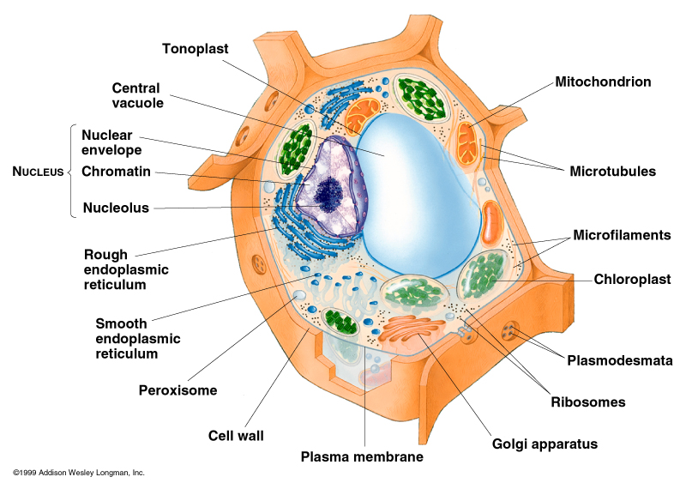
Plant cell

Slide 17
There are many different types of cells.
One major difference in cells occurs between plant cells and animal cells.
Many animals have skeletons to give their body structure and support.
Plants do not have a skeleton for support.
This is because of a unique cellular structure called the cell wall.
The cell wall is a rigid structure outside of the cell membrane composed mainly of the polysaccharide cellulose.

Slide 18
In addition to the cell wall, plant cells contain an organelle called the chloroplast.
The chloroplast allow plants to harvest energy from sunlight. Specialized pigments in the chloroplast (including the common green pigment chlorophyll) absorb sunlight and use this energy to complete the chemical reaction:
6 CO₂ + 6 H₂O + energy (from sunlight).> C₆H₁₂O₆ + 6 O₂

Slide 19
WHAT IS A CELL?
Cells are the structural and functional units of all living organisms.
Some organisms, such as bacteria, are unicellular, consisting of a single cell.
Other organisms, such as humans, are multicellular, or have many cells.
Each cell is an amazing world unto itself: it can take in nutrients, convert these nutrients into energy, carry out specialized functions, and reproduce as necessary.

Slide 20
Basic Types
Eukaryotes- organisms whose cells contain a membrane-bound nucleus and other membrane-bound organelles.
Prokaryotes- organisms that do not have a membrane-bound nucleus or membrane-bound organelles.

Slide 21
Red blood cells
Red blood cells (abbreviated RBCs; also referred to as erythrocytes or simply, as red cells) are the most common type of blood cell and the vertebrate organism's principal means of delivering oxygen (O₂) to the body tissues via the blood flow through the circulatory system.
They take up oxygen in the lungs or gills and release it while squeezing through the body's capillaries.
These cells' cytoplasm is rich in haemoglobin, an iron-containing biomolecule that can bind oxygen and is responsible for the blood's red color.

Slide 22
In humans, mature red blood cells are flexible biconcave disks that lack a cell nucleus and most organelles.
2.4 million new erythrocytes are produced per second.
The cells develop in the bone marrow and circulate for about 100–120 days in the body before their components are recycled by macrophages.
Each circulation takes about 20 seconds. Approximately a quarter of the cells in the human body are red blood cells

Slide 23
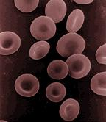
Structure of RBCS

Slide 24
CELL ORGANELIES
Within cells there is an intricate network of organelles that all have unique functions.
These organelles allow the cell to function properly. Arranged below according to location (nucleus, cytoplasm, and surface) is a description of common organelles
Cell wall Centrioles Chloroplasts Chromosomes Cytoskeleton Endoplasmic reticulum Nuclear membrane
Nucleolus Golgi apparatus Lysosome Mitochondria Plasma membrane Ribosomes Vacuoles

Slide 25
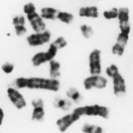
NUCLEUS:
One or more per cell
Spherical shape
Denser than surrounding cytoplasm
Chromosomes - Usually in the form of chromatin - Contains genetic information - Composed of DNA - Thicken for cellular division - Set number per species (i.e. 23 pairs for human)

Slide 26
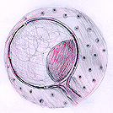
Nuclear membrane
- Surrounds nucleus - Composed of two layers - Numerous openings for
nuclear traffic

Slide 27
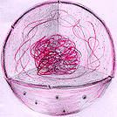
Nucleolus
- Spherical shape - Visible when cell is not dividing - Contains RNA for protein manufacture

Slide 28
cytoplasm
Collective term for cytosol and organelles contained within
Colloidal suspension
Cytosol mainly composed of water with free-floating molecules
Viscosity constantly changes

Slide 29
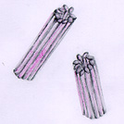
Centrioles - Paired cylindrical organelles near nucleus - Composed of nine tubes, each with three tubules - Involved in cellular division - Lie at right angles to each other

Slide 30
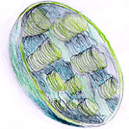
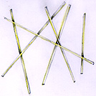
Chloroplasts - A plastid usually found in plant cells - Contain green chlorophyll where photosynthesis takes place
--------------------------------------------------------------
Cytoskeleton - Composed of microtubules - Supports cell and provides shape - Aids movement of materials in
and out of cells

Slide 31
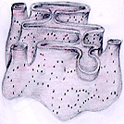
Endoplasmic reticulum: - Tubular network fused to nuclear membrane - Goes through cytoplasm onto cell membrane - Stores, separates, and serves as cell's transport system - Smooth type: lacks ribosomes - Rough type (pictured): ribosomes embedded in surface

Slide 32
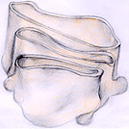
Golgi apparatus
- Protein 'packaging plant' - A membrane structure found near nucleus - Composed of numerous layers forming a sac

Slide 33
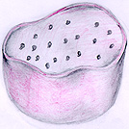
Lysosome - Digestive 'plant' for proteins, lipids, and carbohydrates - Transports undigested material to cell membrane for removal - Vary in shape depending on process being carried out - Cell breaks down if lysosome explodes

Slide 34
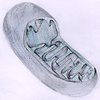
Mitochondria: - Second largest organelle with unique genetic structure - Double-layered outer membrane with inner folds called cristae - Energy-producing chemical reactions take place on cristae - Controls level of water and other materials in cell - Recycles and decomposes proteins, fats, and carbohydrates, and forms urea

Slide 35
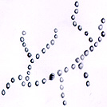
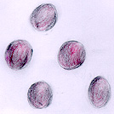
Ribosomes - Each cell contains thousands - Miniature 'protein factories' - Composes 25% of cell's mass - Stationary type: embedded in
rough endoplasmic reticulum - Mobile type: injects proteins directly
into cytoplasm
Vacuoles - Membrane-bound sacs for storage,
digestion, and waste removal - Contains water solution - Contractile vacuoles for water removal
(in unicellular organisms)

Slide 36
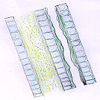
Cell wall - Most commonly found in plant cells - Controls turgity - Extracellular structure surrounding plasma membrane - Primary cell wall: extremely elastic - Secondary cell wall: forms around primary cell wall after growth is complete

Slide 37
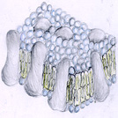
Plasma membrane - Outer membrane of cell that controls cellular traffic - Contains proteins (left, gray) that span through the membrane and allow passage of materials - Proteins are surrounded by a phospholipid bi-layer.

