Slide 1
CYTOSKELETON
MICROFILAMENTS/ACTIN FILAMENTS
2. INTERMEDIATE FILAMENTS
3. MICROTUBULES

Slide 2
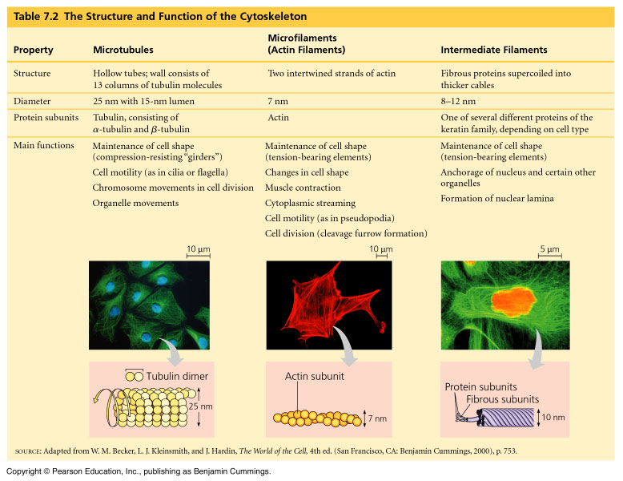

Slide 3
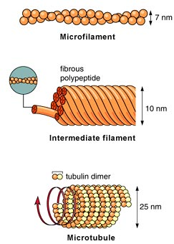
CYTOSKELETON

Slide 4
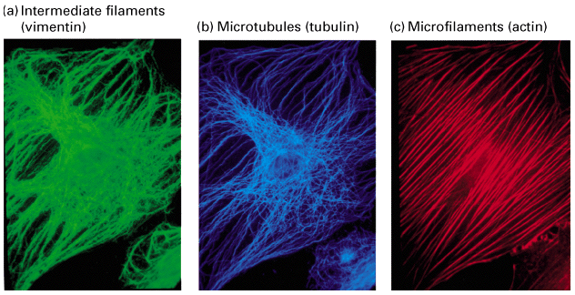
Cytoskeleton
Made of proteins
Dynamic properties
Coordinate with each other
Coordinate with external signal

Slide 5
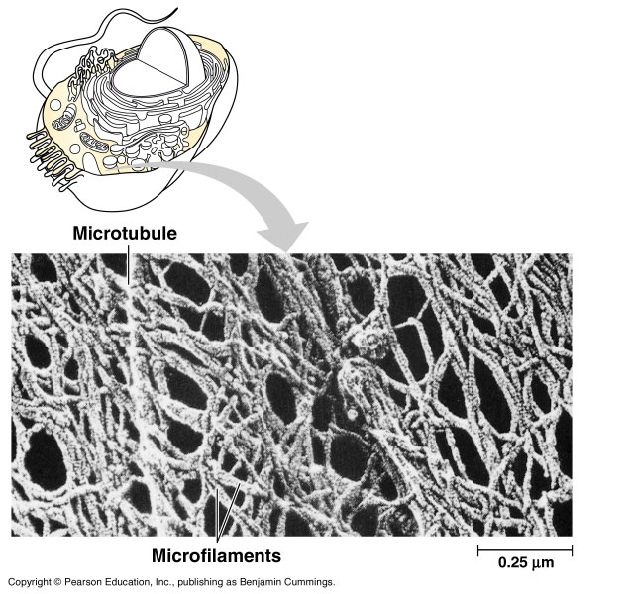
Introduction
The cytoskeleton is a network of fibers extending throughout the cytoplasm.
The cytoskeleton
organizes the
structures and
activities of
the cell.

Slide 6
I.MICROFILAMENTS/ACTINFILAMENTS
Skeleton" contained within a cell's cytoplasm and is made UP of protein
Present in eukaryotic cells ,
Recent research has identified the prokaryotic cytoskeleton.
50 to 70 A⁰ / 5-7 NM. in diameter.
In cluster beneath cell membrane

Slide 7
Formed from globular proteins & similar to actin of muscles hence called actin filament.
Arranged in two different ways-
a) Lie parallel bundles near the surface of the cell membrane, e.g. cleavage furrow dividing cell.
These bundles also contain other muscle proteins like myosin, tropomyosin & alpha atinin in clustered cells

Slide 8
b) In second they are in loose network,
e.g. Pseudopodia in Amoeba and WBCs
Also involved in movement associated with furrow formation in cell division, cell migration during embryonic development
Form major component of the cells
Acts as contractile machinery, thus muscle cells richly supplied with microfilaments
Made up of actin, myosin & myosin protein
In non muscle cells found in cortical region nr. Plasma membrane

Slide 9
The major cytoskeletal protein of most of the cells is actin.
Actin was first isolated from muscle cell in 1942 constitute 20 percent of cell protein
Yeasts have single actin gene, while higher eukaryotes have several distinct type of actin
In mammals have six actin genes, which are very similar in amino acid sequence

Slide 10
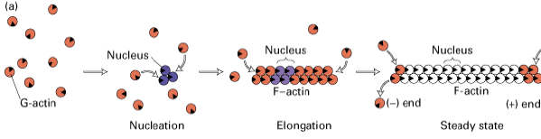
Polymerization of G-actin.
Actin monomers polymerise to form actin filament
(positive end elongates 5-10 times faster than –ve end)

Slide 11
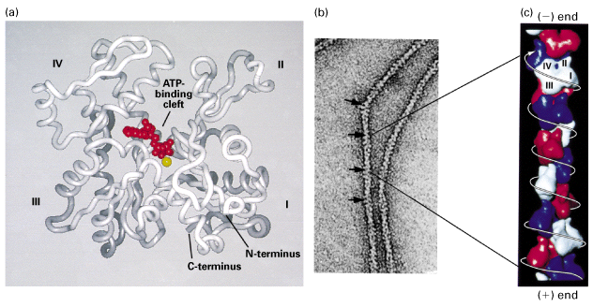
Actin cytoskeleton a) G-actin b)F-actin
Mg++-
+

Slide 12
Functions of Microfilaments
Responsible for muscle contraction due to high concentration
Cell movement
Tubular gland formation
Gastrulation: cell migration during embryonic development
Cell division: cleavage furrow formation
Involved in cytokinesis
Responsible for nerve outgrowth

Slide 13
OTHER FUNCTIONS:
Actin filaments are concentrated beneath the plasma membrane (cell cortex) and give support to the cell
mechanical strength.
Assembly of actin filaments can determine cell shape and cause cell movement.
Association of actin filaments with myosin can form
contractile structures.

Slide 14
INTERMEDIATE FILAMENTS
Intermediate size about 10 nm
(actin-7 nm & microtubule 25nm)
Tubular in str. Made up of 4-5 protofilaments arranged in parallel fashion
Not directly involved in cell movements
Plays role by providing mechanical support to cells and tissues
Contractile units in the cell

Slide 15
Actin filaments & microtubules are poloymers of single type of protein(actin & tubulin)
Intermediate f. composed of variety of proteins and are expressed in different types of cells
More than 50 diff. types intermediate filaments proteins identified
Based on similarities between their A. Acid sequences classified in to 6 groups.

Slide 16
TYPE | PROTEIN FILAMENT | SIZE(Kd.) | SITE OF EXPRESSION
I | Acidic keratins (15 proteins) | 40-60 | Epithelial cells
II | NEUTRAL/BASIC KERATINS (Hard and soft) | 50-70 | Epithelial cells
III | VIMENTIN Insoluble and bind to nu. Envelope & polar body/ centrioles DESMIN GLIAL FIBRILLAR ACIDIC PROTEIN PERIPHERIN | 54 53 51 57 | Smooth muscle cells, fibroblasts ,WBCs & other cell types Muscle cells Glial cells ( support and nutrition to nerve cells) Peripheral neurons (P.N.S.)
IV | NEUROFILAMENT PROTEINS N.F.- Light N.F. – Medium N.F. – Heavy | 60-70 105-110 135-150 | Neurons/ nerve cells (Supporting long thin processes)
V | NUCL EAR LAMINS. A, B & C (Vital, form nu. Memb. after cell division) | 60-75 | Nuclear lamins of all cells
VI | NESTIN | 200 | Stem cells of C.N.S.

Slide 17
Microtubule
Microtubules are long, hollow cylindrical & filamentous or fibrillar structures found in the cytoplasm of all eukaryotic cells
First observed by De Roberties and Franchi (1953) in nerve fibres
Named as Microtubule by Slautterback (1963)
They shows similarity with the fibrilar elements of cilia and flagella hence the name Microtubule.
Absent in prokaryotes

Slide 18
They may be labile or stable
Labile Microtubules are easily disrupted by the treatment of inhibitors such as vinblastin, colchicine
E g- Microtubules of pseudopodia of amoeba and mitotic spindle fibres
Stable Microtubules are not easily disrupted by the treatment of inhibitors. e.g. microtubules of cilia &
flagella

Slide 19
Structure of Microtubules
Microtubules are long and hollow cylinders, composed of many subunits called as protofilaments.
The number of protofilaments is variable
A T.S. of cytoplasmic microtubule shows 13 subunits or protofilaments
They lie parallel to the long axis of the microtubule
Neurotubules are composed of 13 protofilaments
Cockroach epidermis-15 protofilaments

Slide 20
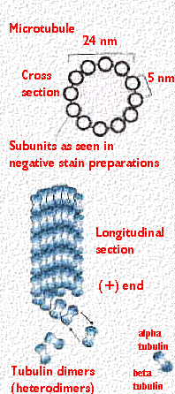
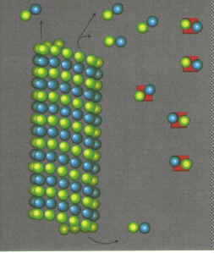
Outer diameter of cylinder of the microtubule is 240 A⁰/24 nm
Diameter of hollow core is 150 A⁰/ 15nm
Thickness of wall is 50 A⁰/ 5 nm
Length of microtubule is few micron several micron
Some cases several millimeters
The protofilamets are composed of globular protein
(Tubulin) units.

Slide 21
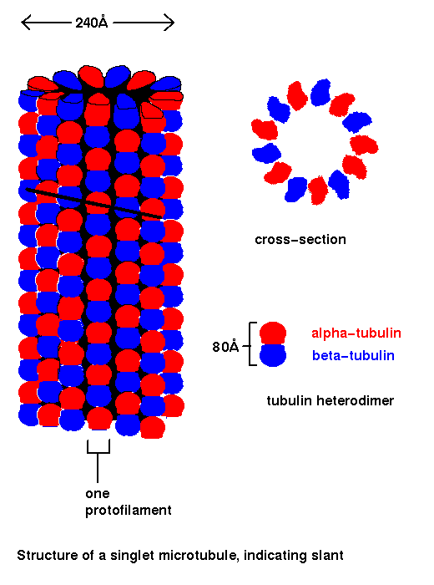
Tubulin is dimer made up of 2 similar polypeptides
The 2 units of tubulin dimer is alpha tubulin & beta tubulin
These units are arranged alternately in the protofilaments
Molecular wt. of alpha tubulin is 55000 Dalton,
Molecular wt. of beta tubulin is 57000 Dalton
Amino acid composition in both are similar

Slide 22
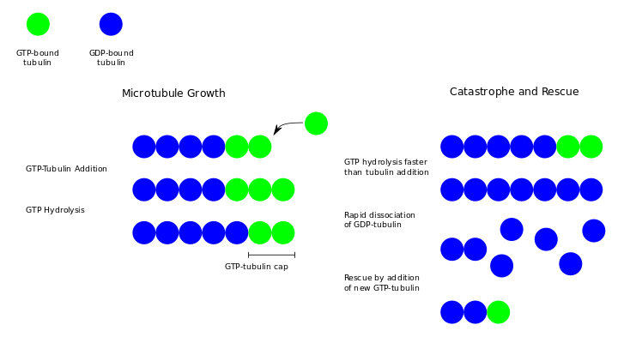

Slide 23
Functions of Microtubules
Maintenance of cell shape: Rigid strs. Supporting cytoskeleton give shape to the cell
Changes in the cell shape (morphogenesis): MicrotubulesChanges in the cell shape during cell differentation. Eg –elongation of cells in the lens of eye and nucleus of spermatid during sperm formation
Transport of cellular material: Neurofilaments and Microtubules found in the axons of the nerve cells transport protein and other substances from cell body to the axons
Release of insulin from the beta cells of pancreas
Sensory transduction: Many Microtubules of sensory cells acts as transducers convert stimuli in to nerve impulses
Chromosomal movement in cell division: During mitosis and meiosis spindle fibers appeared are bundles of microtubules
Movement of cilia and flagella: The central axis or axoneme of cilia and flagella is made up Microtubules, which involved in the movement of cilia and flagella

Slide 24
OTHER FUNCTIONS:
1. To form an architectural framework that establishes the overall polarity of the cell by influencing the organization of the nucleus, organelles, and other cytoskeleton components.
2. To form the spindle apparatus and ensure the proper segregation of duplicated chromosomes into daughter cells during cell division (aka cytokinesis). The spindle apparatus also regulates the assembly and location of the actin-rich contractile ring that pinches and separates the two daughter cells.
3. To form an internal transport network for the trafficking of vesicles containing essential materials to the rest of the cell.
4. To form a rigid internal core that is used by microtubule-associated motor proteins to generate force and movement in motile structures such as cilia and flagella. A core of microtubules in the neural growth cone and axon also imparts stability and drives neural navigation and guidance.

Slide 25
Comparison of some properties of microfilaments, intermediate filaments & microtubules
PROPERTY | Microtubules | Intermediate filaments | Microfilaments
STRUCTURE | Hollow, cylindrical made up of 13 protofilaments | Hollow with 4-5 protofilaments | Solid, made up of polymerized actin. F-Actin
DIAMETER (nm) | 25 nm | 10 nm | 5-7 nm
MONOMER UNIT | Alpha tubulin Beta tubulin | Six types of protein | G. Actin

Slide 26
PROPERTY | Microtubules | Intermediate filaments | Microfilaments
FUNCTIONS | 1. Motility of eukaryotes | 1, Integrate contractile units in muscles | 1. Muscle contraction
 | 2. Chromosomal movement | 2.Mechanical support to cell & nucleus | 2. Cell shape changes
 | 3.Maintain cell shape | 3. Resist to external forces | 3. Cytokines is
 | 4. Morphogenesis |  | 4 . cleavage furrow formation
 | 5.Sensery transduction |  | 5. nerve outgrowth
 | 6. Transport of cellular material |  | 6.Helps in Gastrulation (Epiboly & Emboli)
 | 7.Movement of cilia & flagella

